Slide 1
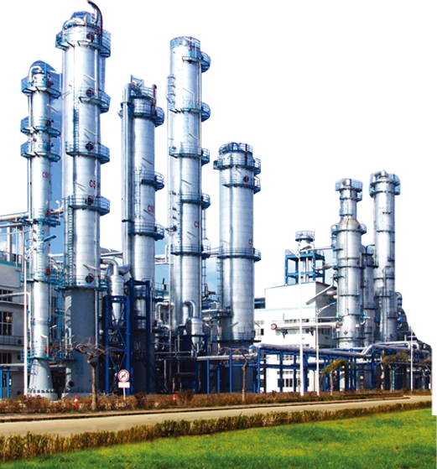
POROYAL TECHNOLOGIES
www.chinaporousfilters.com

Slide 2
www.chinaporousfilters.com
Sintered Metal Porous Filters
Sintered Plastic Porous Filters
POROYAL
Medical & Lab Filters
Titanium & Nickel & Zirconium

Slide 3
01
Sintered Metal Porous Filter
www.chinaporousfilters.com

Slide 4
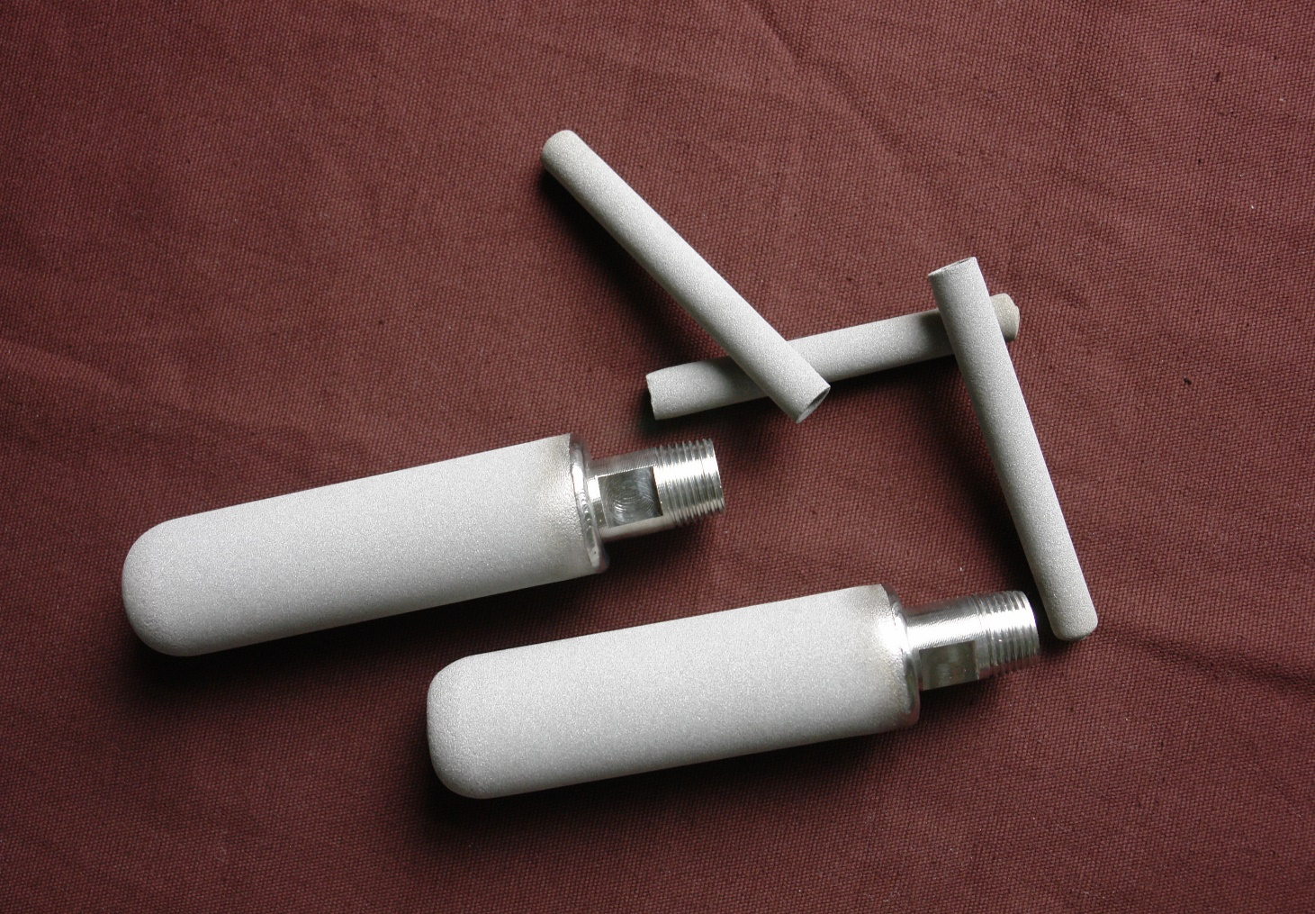
Metal Sintered Porous Filters

Slide 5
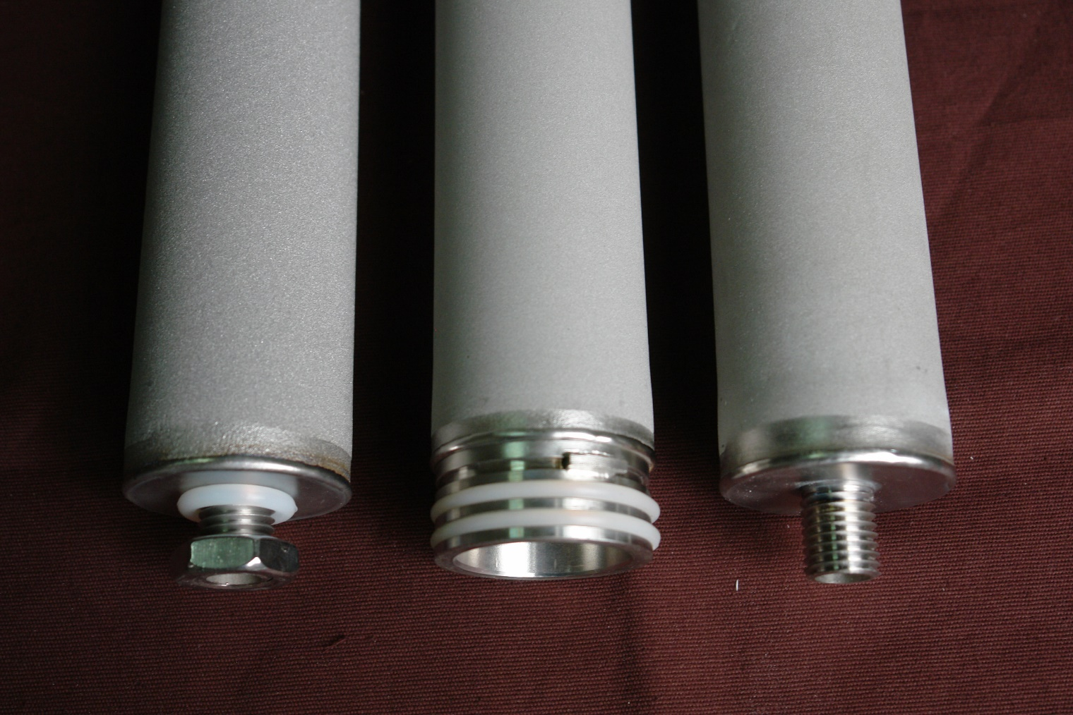
Metal Sintered Porous Filters

Slide 6
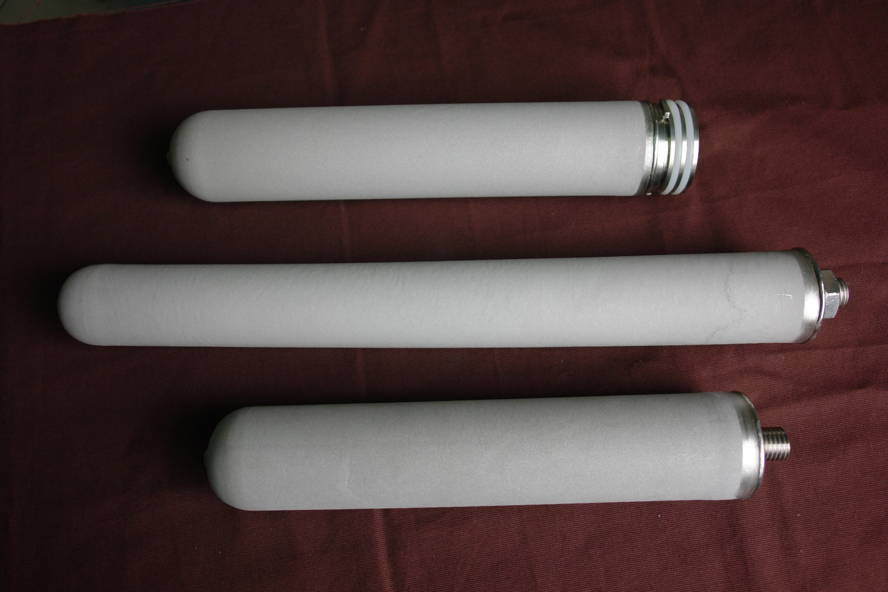
Metal Sintered Porous Filters

Slide 7
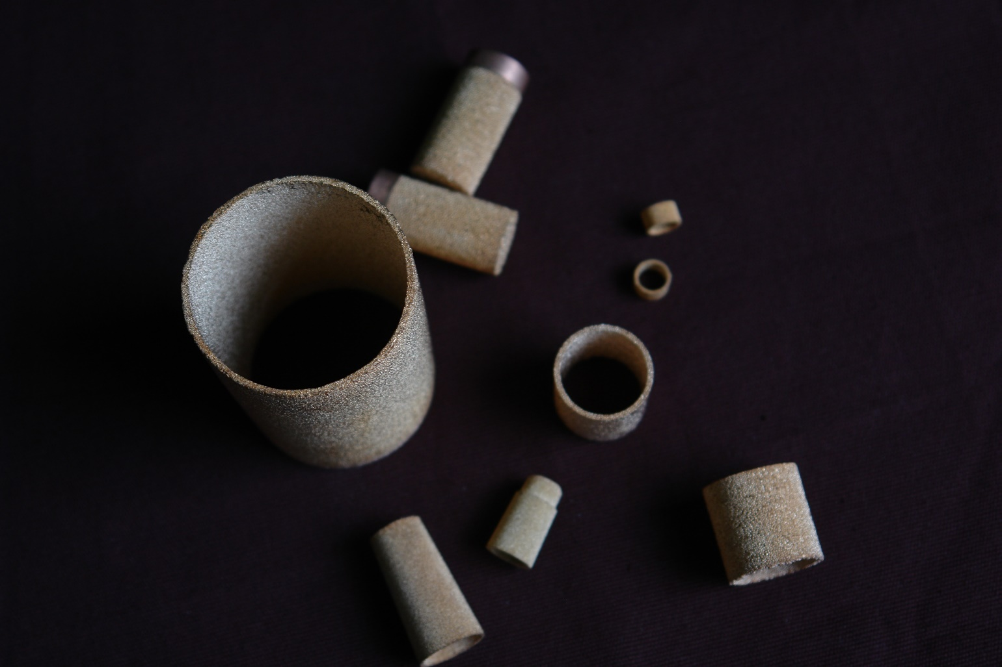
Metal Sintered Porous Filters

Slide 8
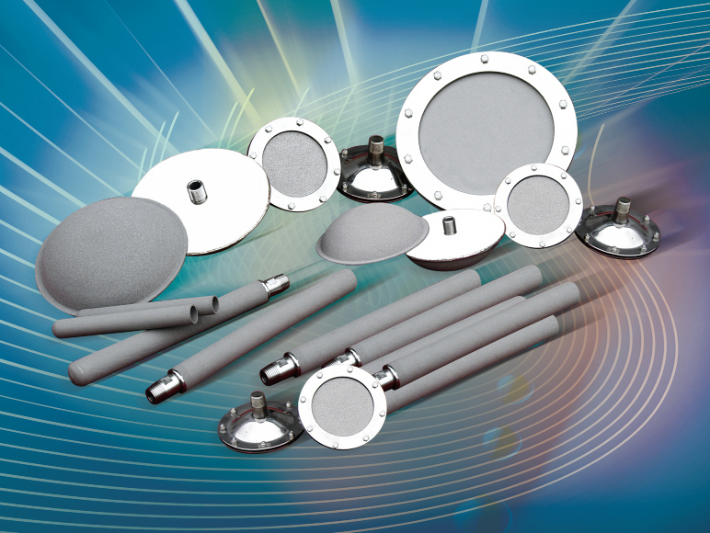
Metal Sintered Porous Filters

Slide 9
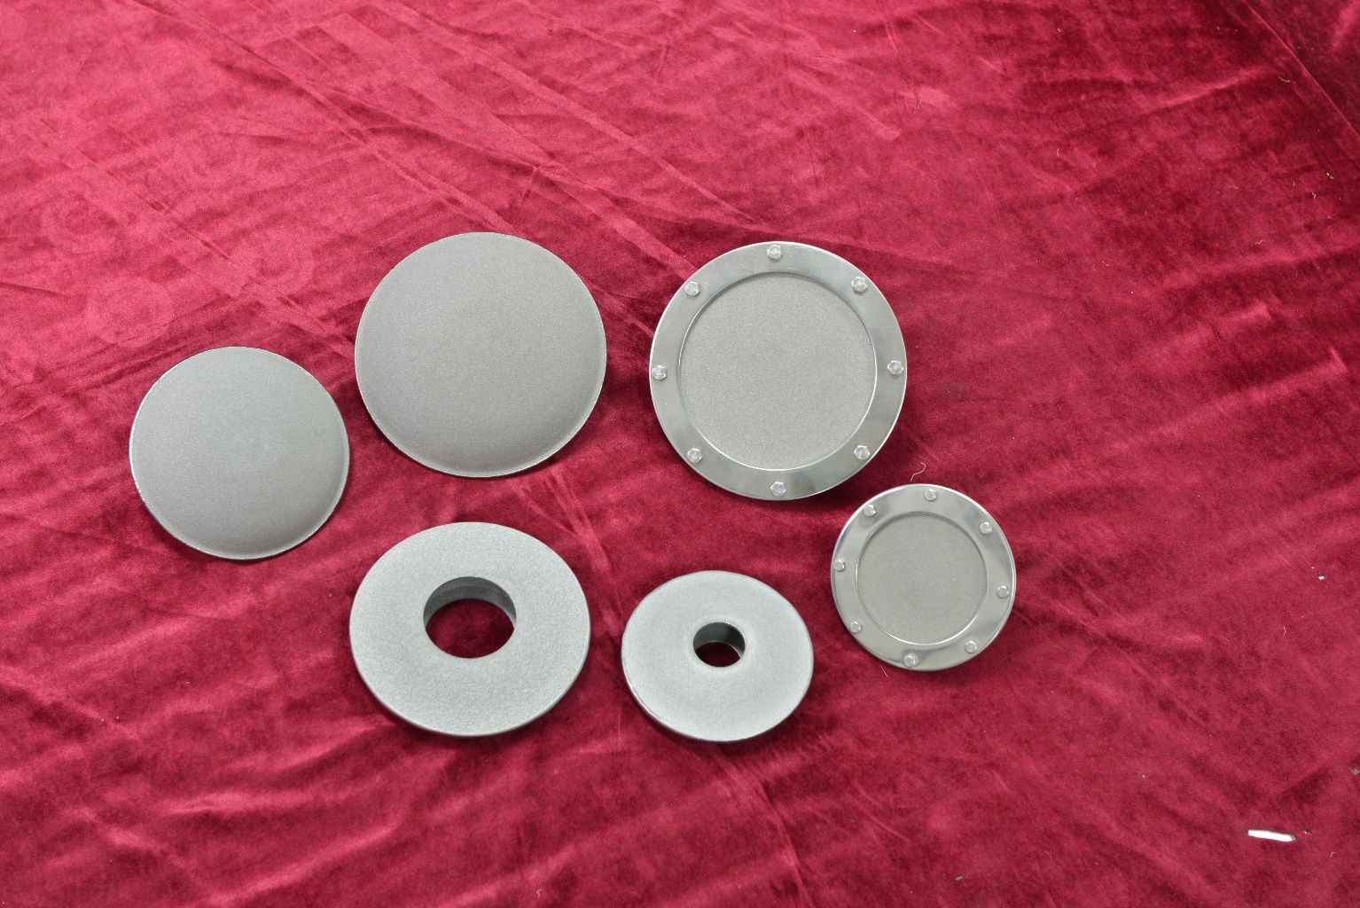
Metal Sintered Porous Filters

Slide 10
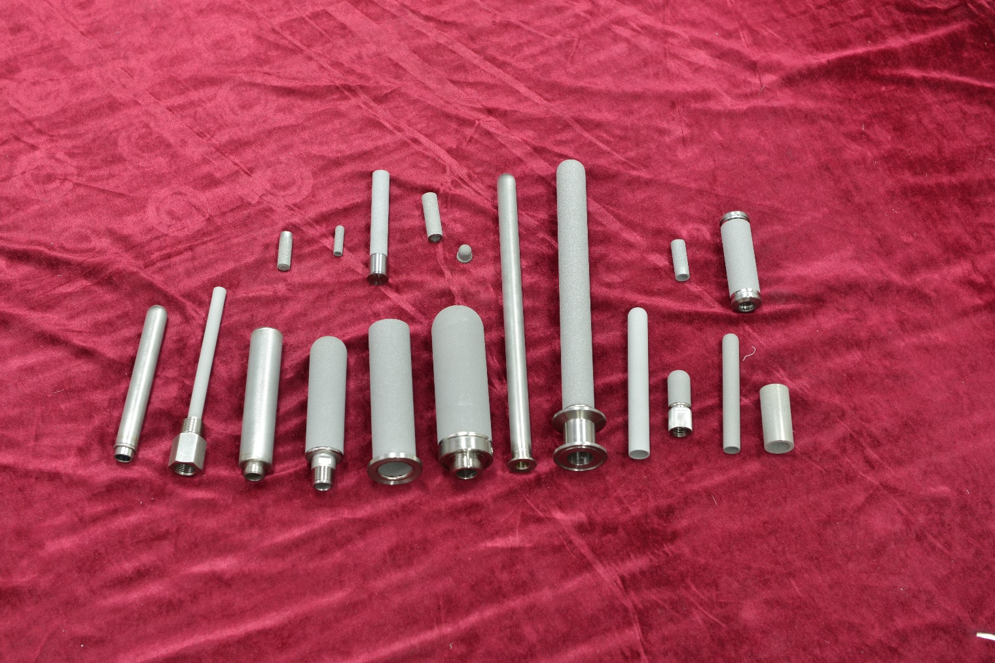
Metal Sintered Porous Filters

Slide 11
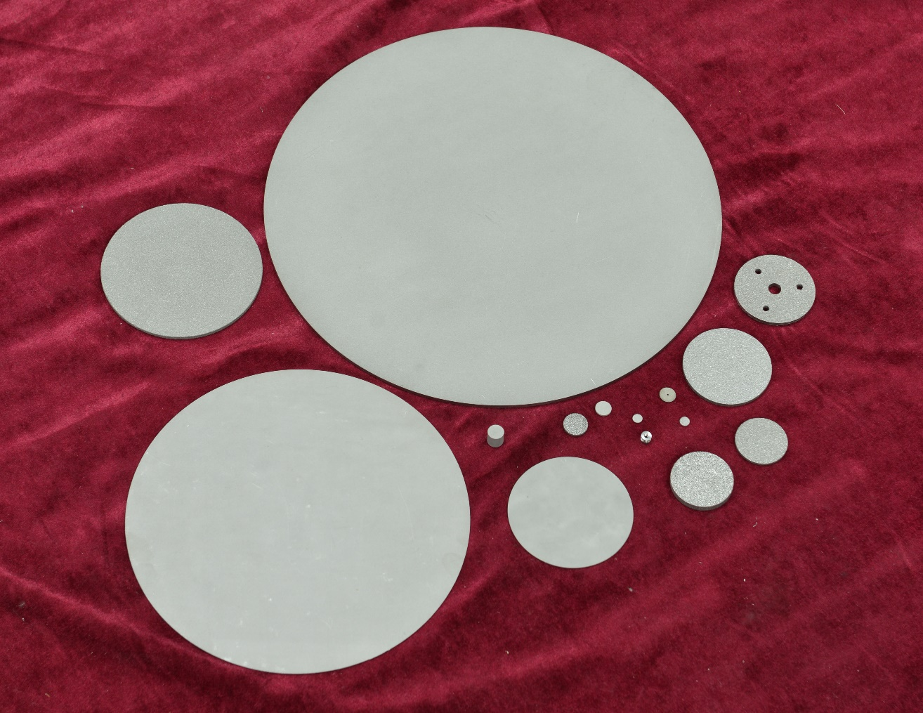
Metal Sintered Porous Filters

Slide 12
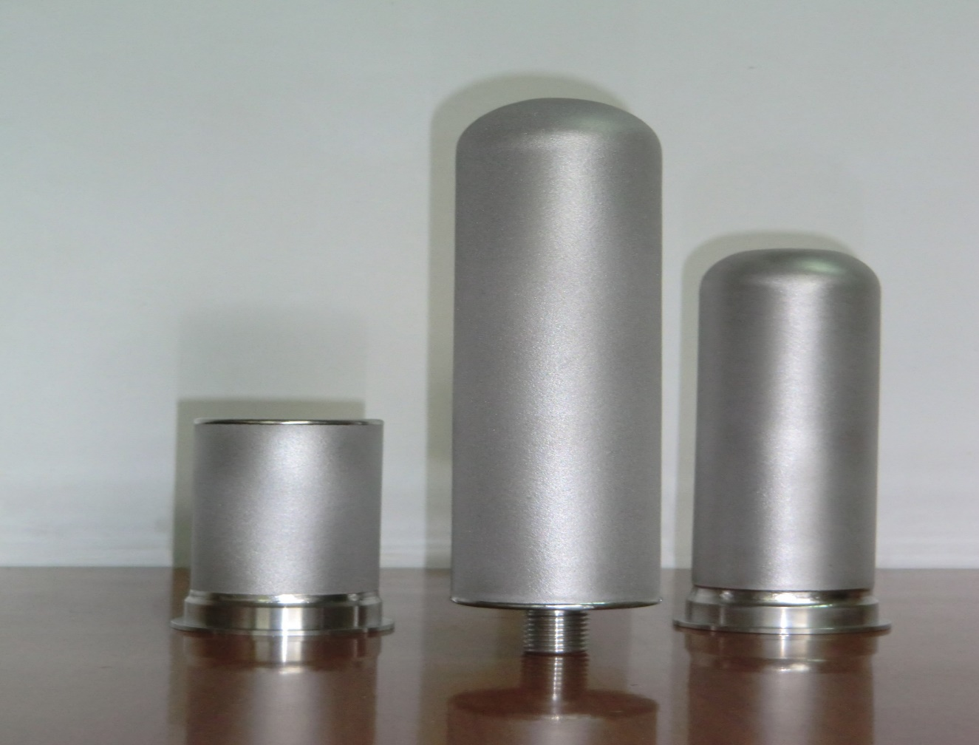
Metal Sintered Porous Filters

Slide 13
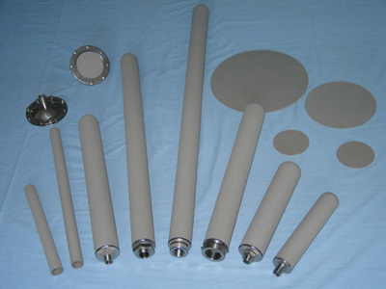
Metal Sintered Porous Filters

Slide 14
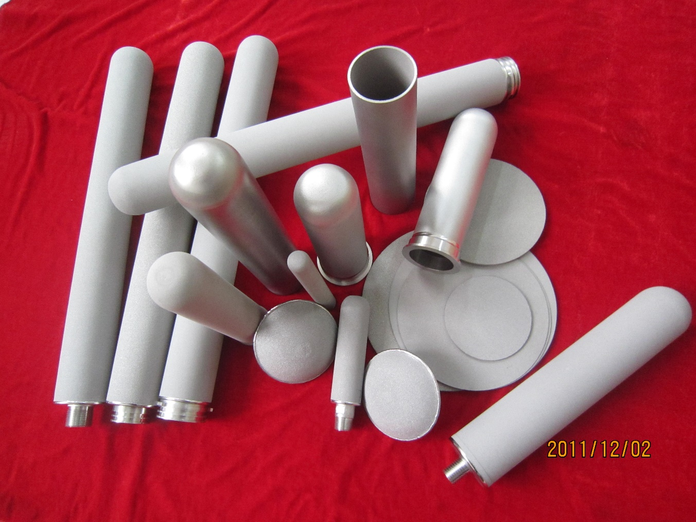
Metal Sintered Porous Filters

Slide 15
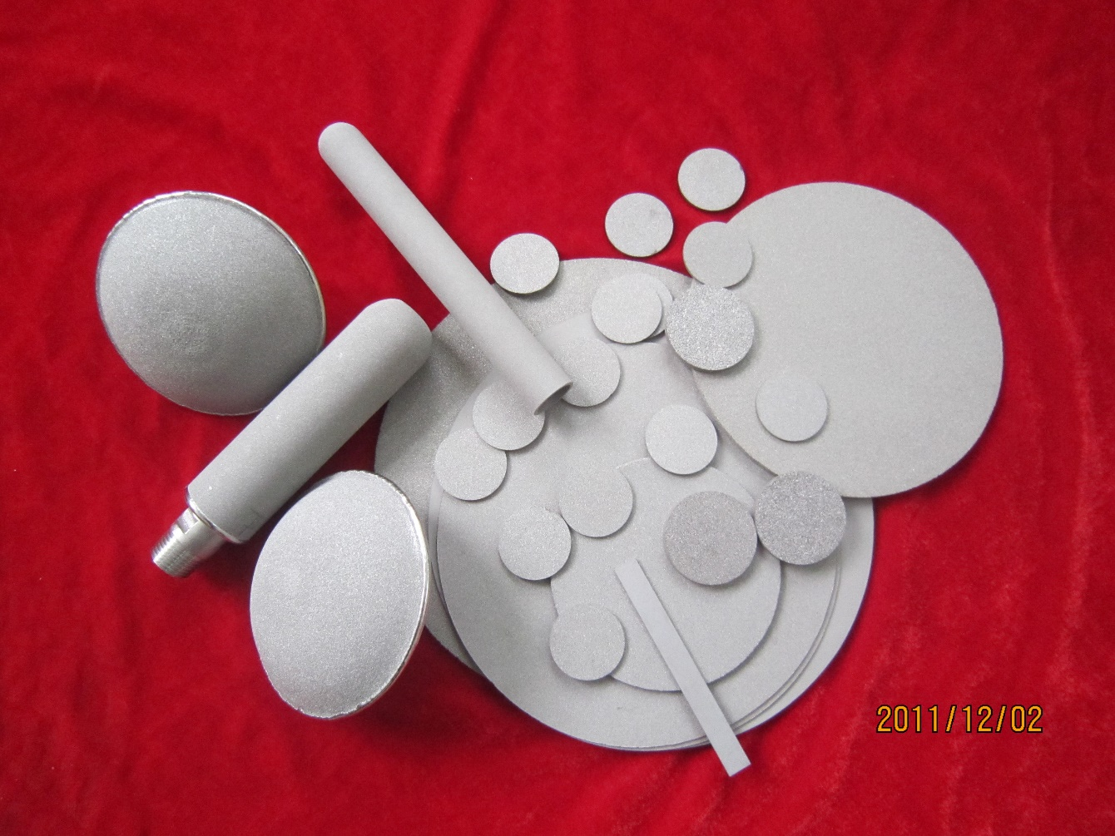
Metal Sintered Porous Filters

Slide 16
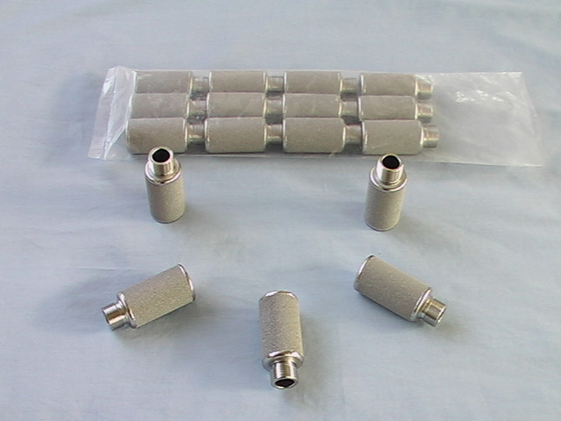
Metal Sintered Porous Filters

Slide 17
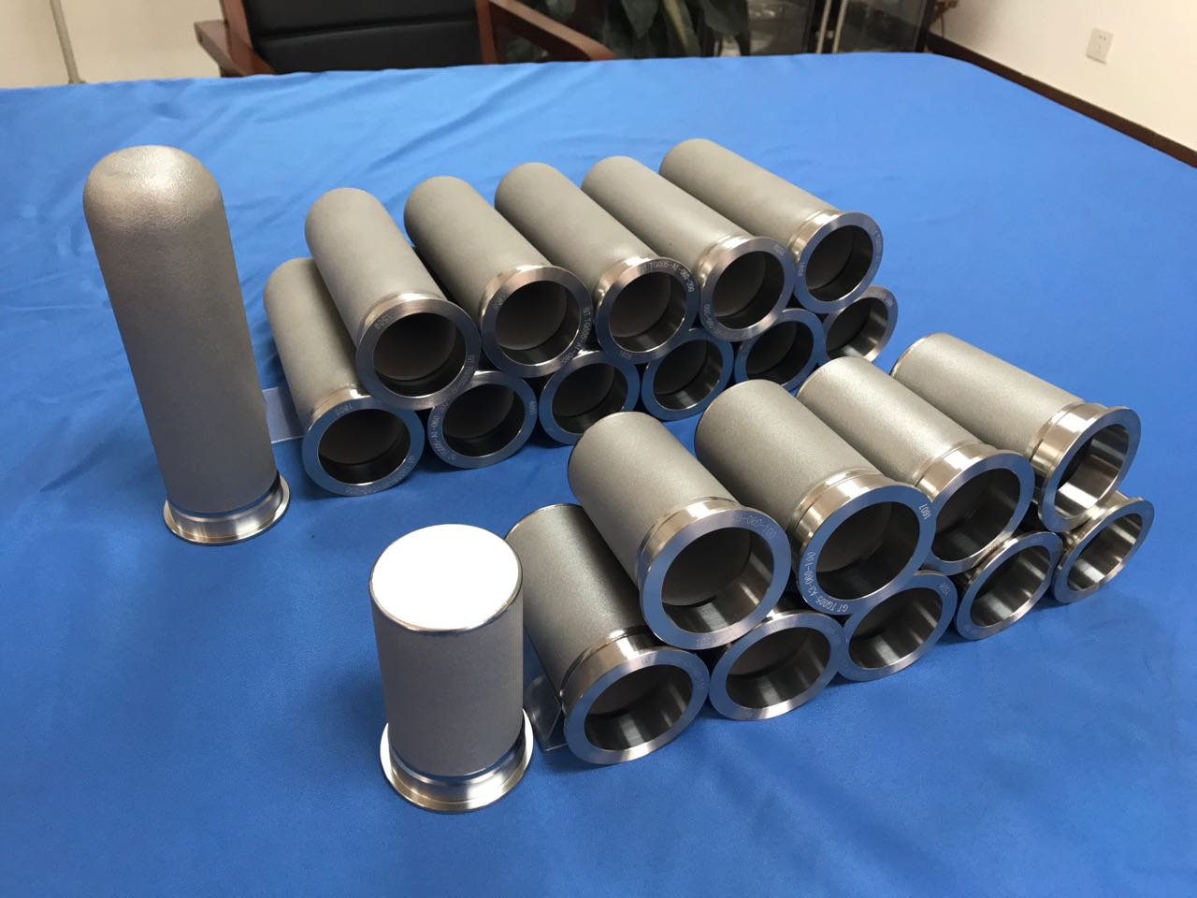
Metal Sintered Porous Filters

Slide 18
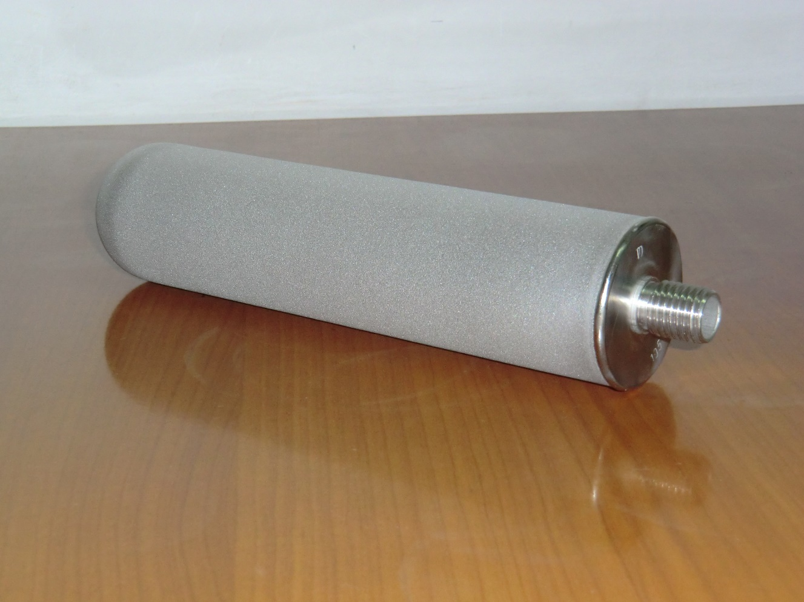
Metal Sintered Porous Filters

Slide 19
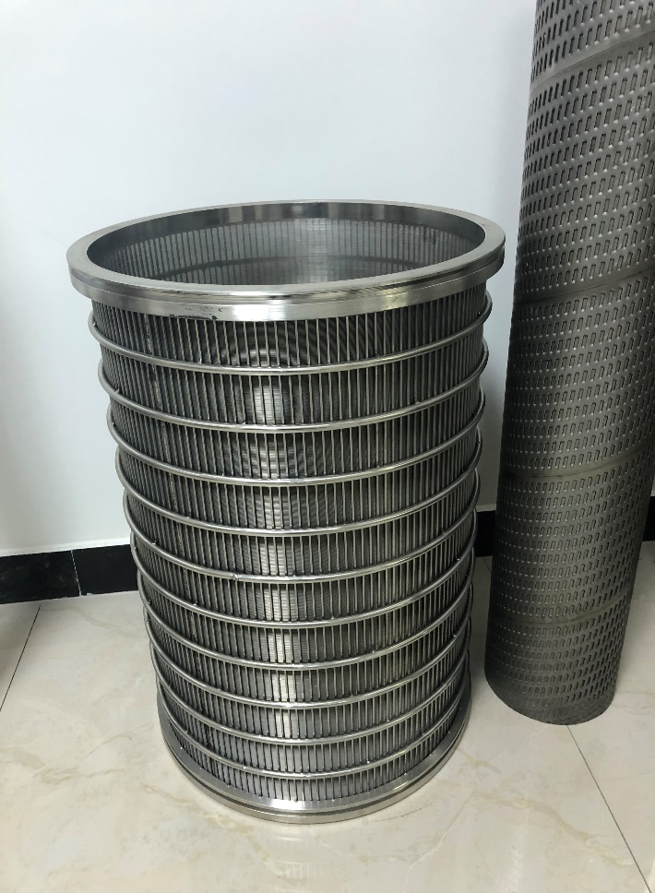
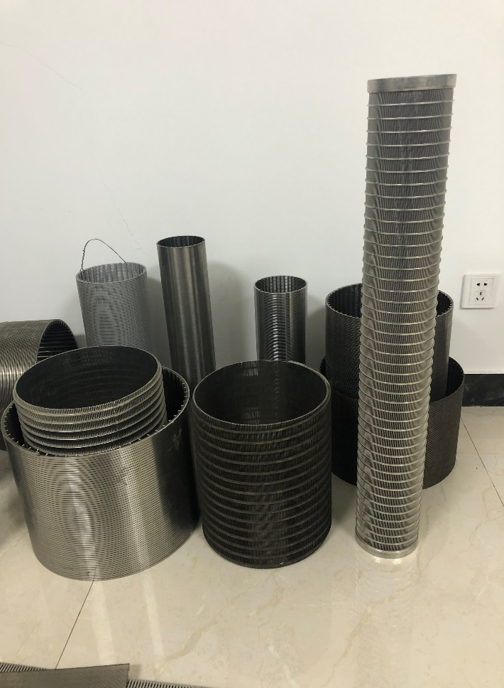
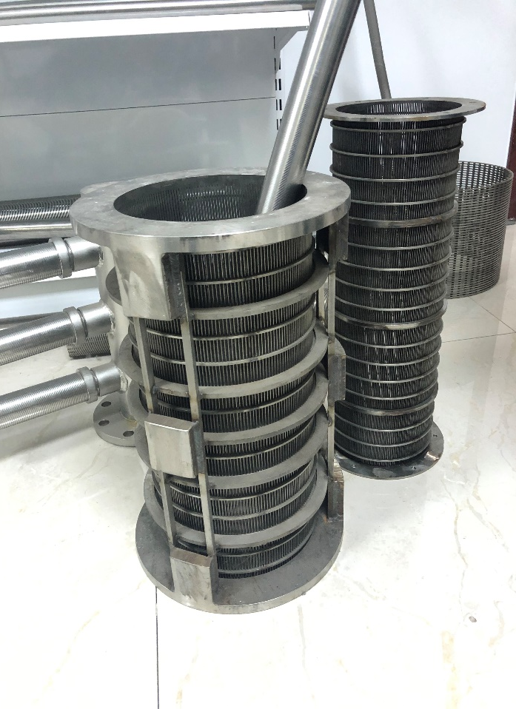
Wedge Wire Mesh Filters

Slide 20
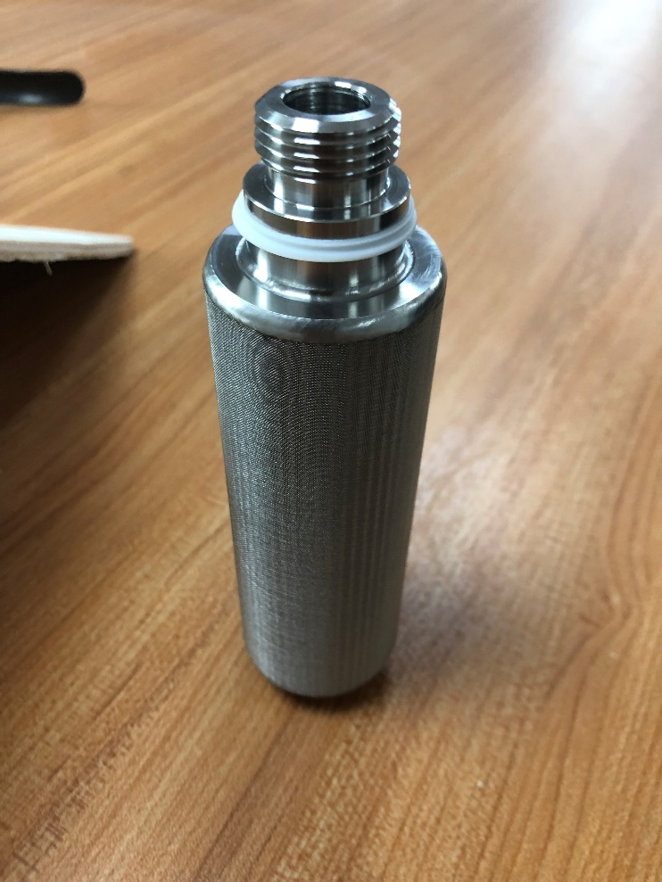
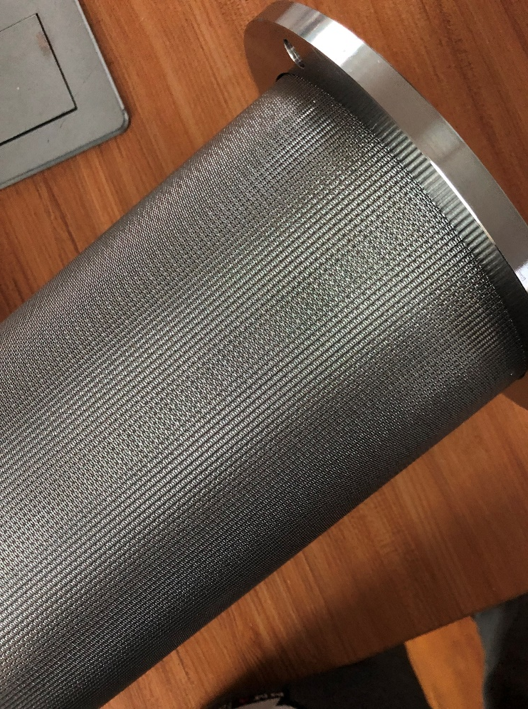
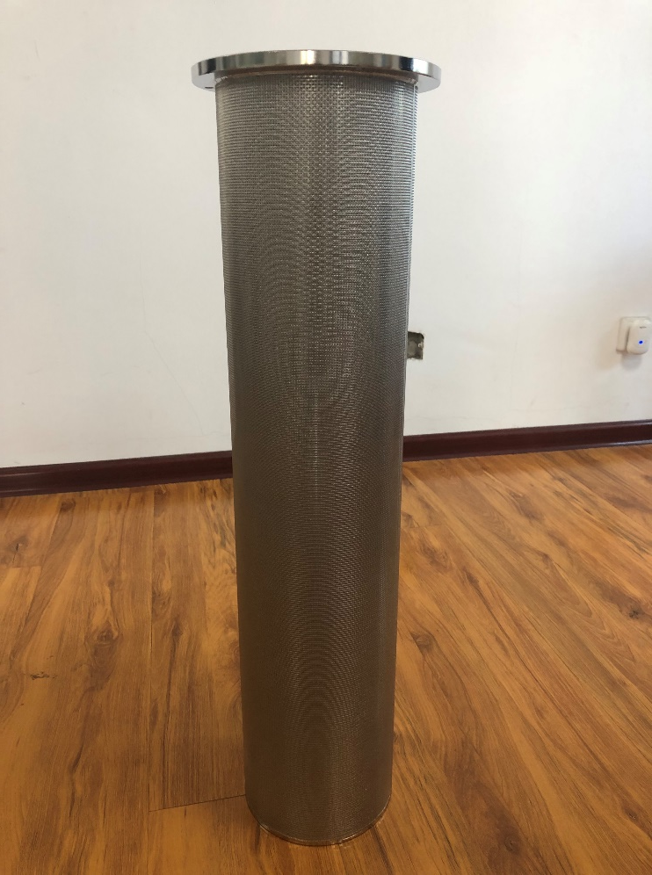
Sintered Multilayered Wire Mesh Filters

Slide 21
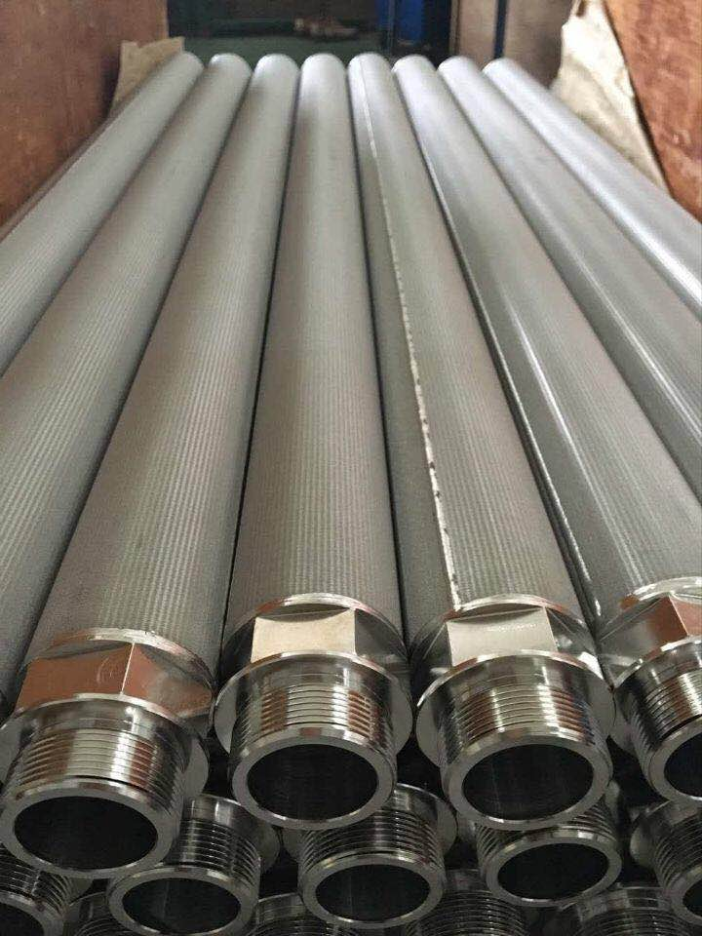
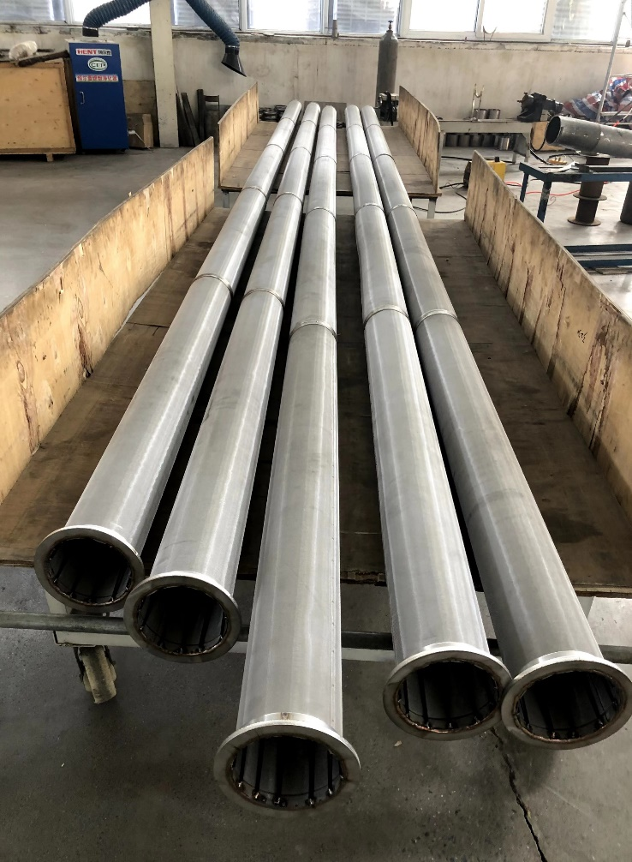
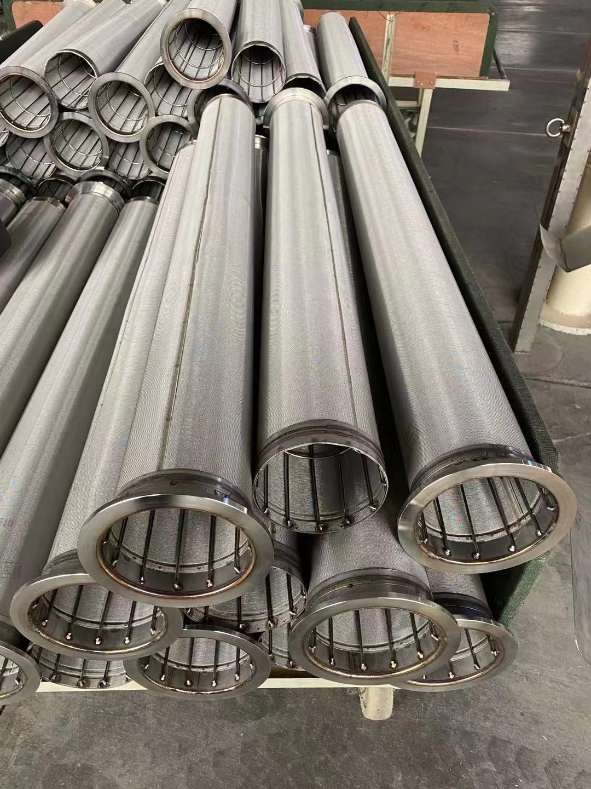
Sintered Multilayered Wire Mesh Filters

Slide 22
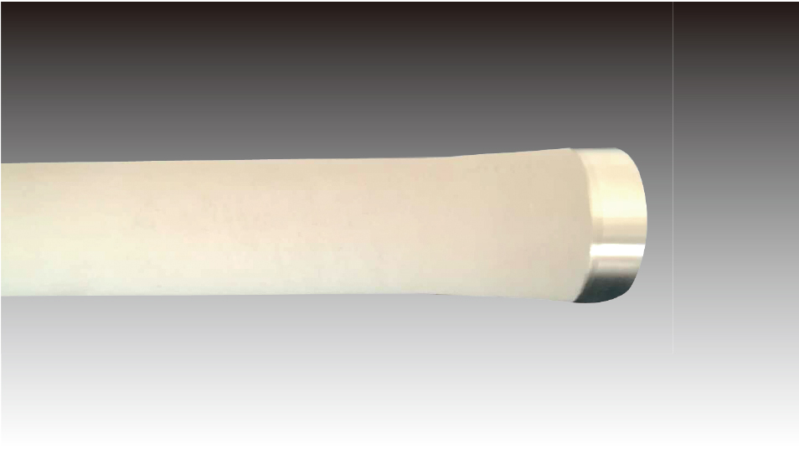
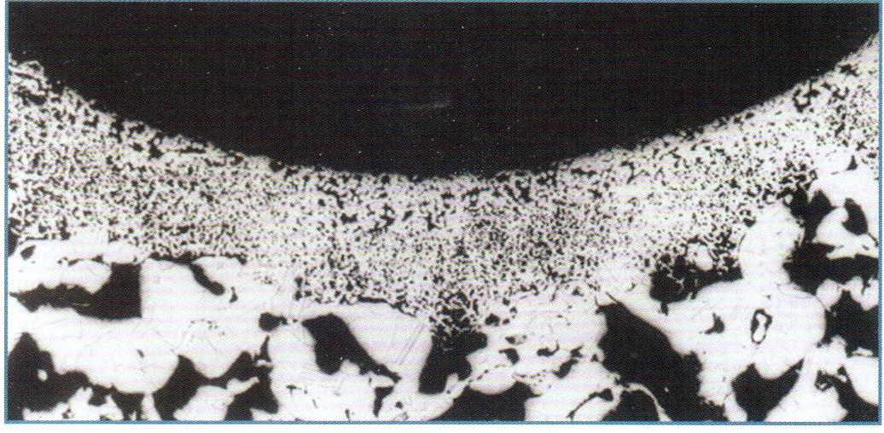
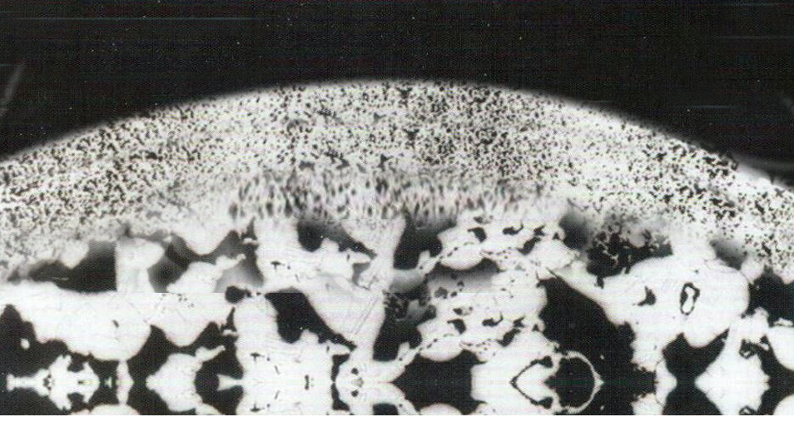
Metal Sintered Porous Filters

Slide 23
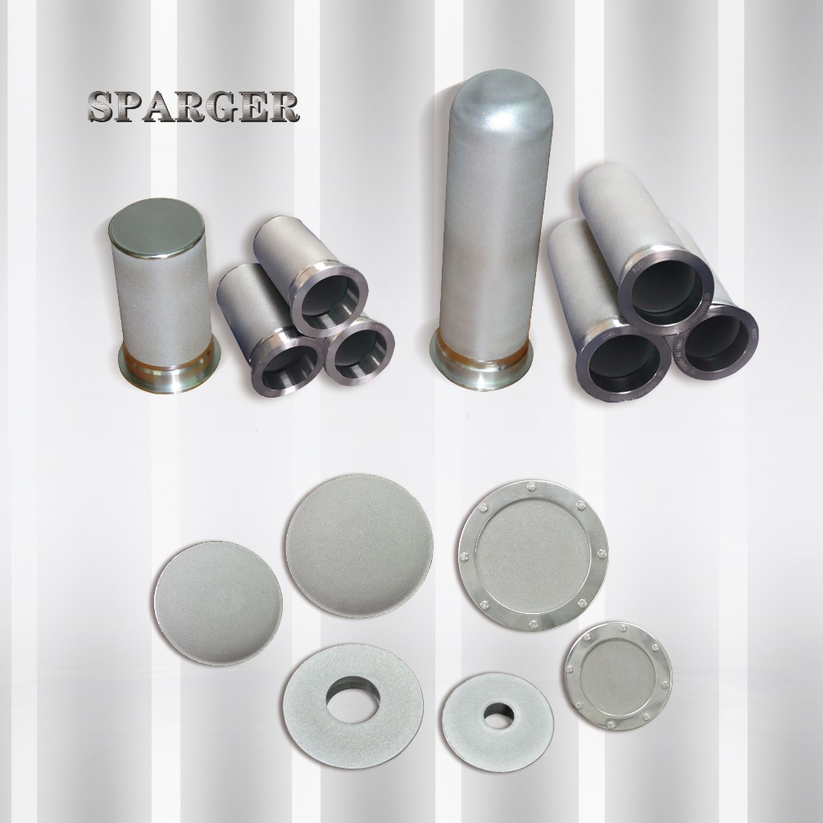
Metal Sintered Porous Filters

Slide 24
www.chinaporousfilters.com
Sintered Metal Porous Filters
Sintered Plastic Porous Filters
POROYAL
Medical & Lab Filters
Titanium & Nickel & Zirconium

Slide 25
02
Titanium & Nickel & Zirconium
www.chinaporousfilters.com

Slide 26
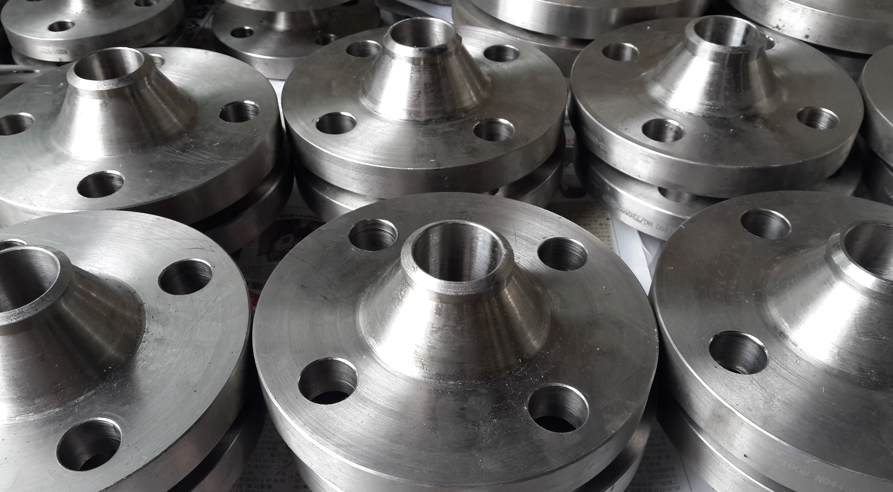
Titanium & Nickel & Zirconium

Slide 27
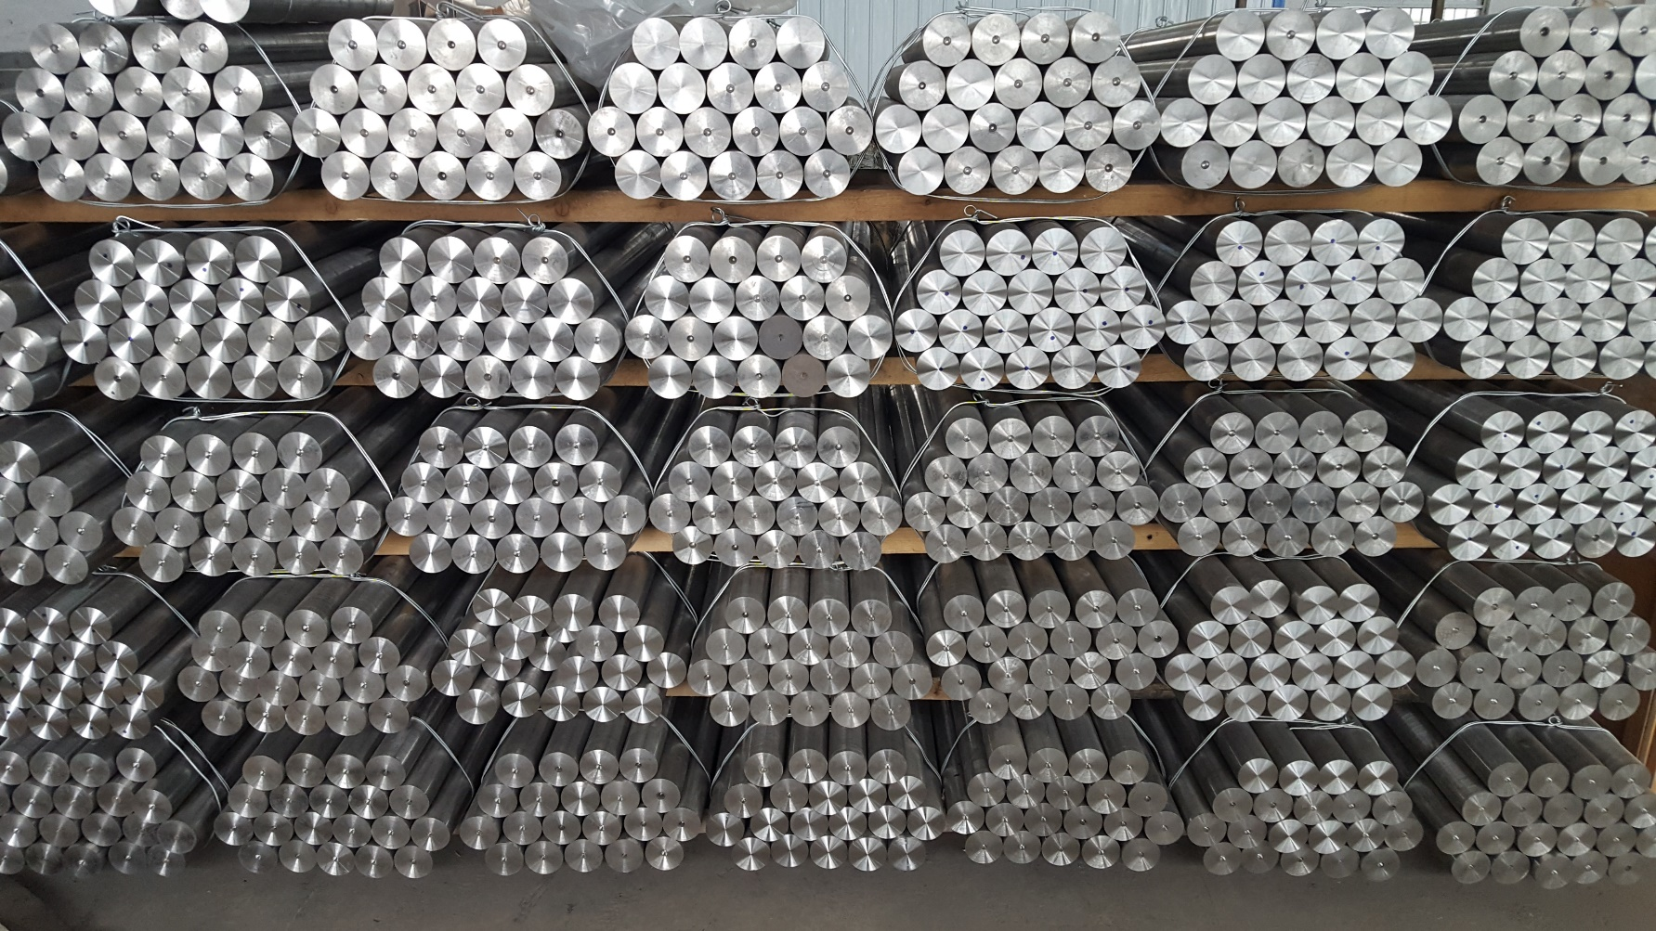
Titanium & Nickel & Zirconium

Slide 28
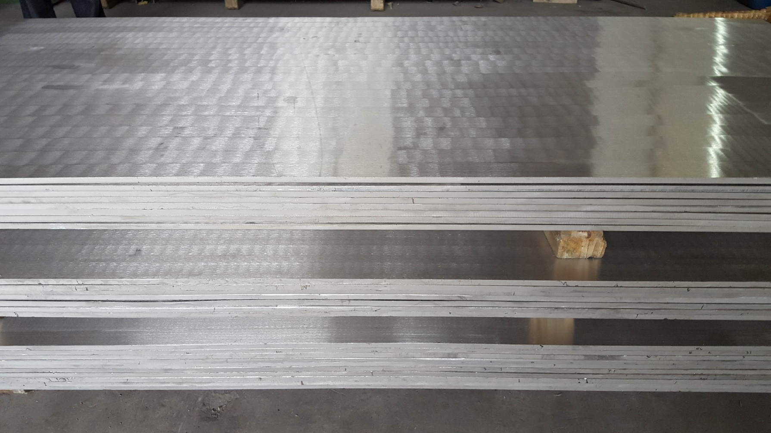
Titanium & Nickel & Zirconium

Slide 29
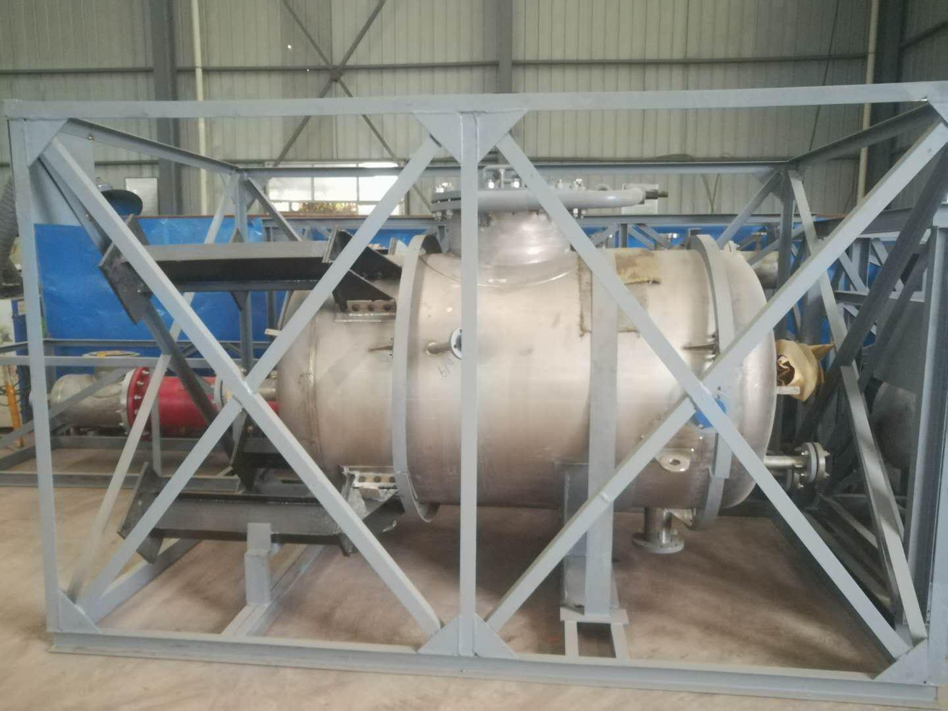
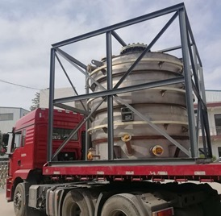
Titanium & Nickel & Zirconium

Slide 30
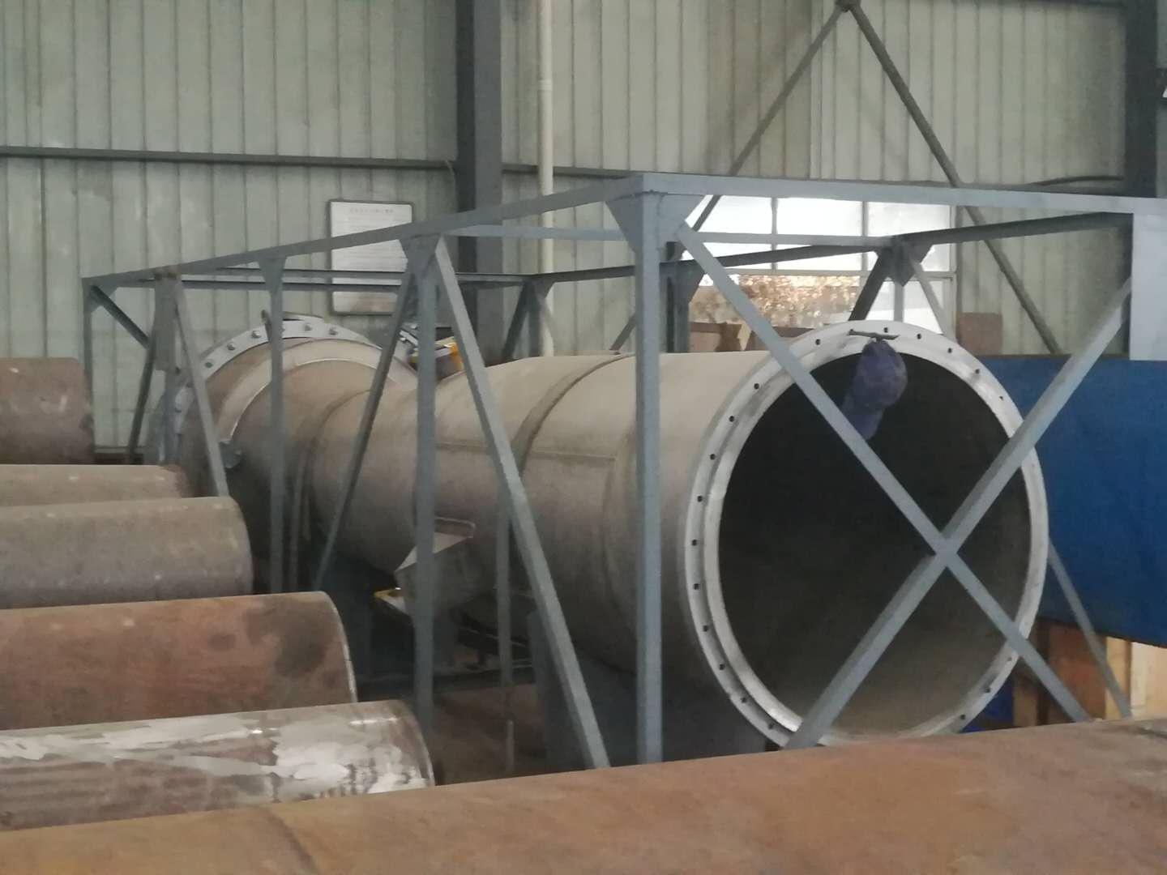
Titanium & Nickel & Zirconium

Slide 31
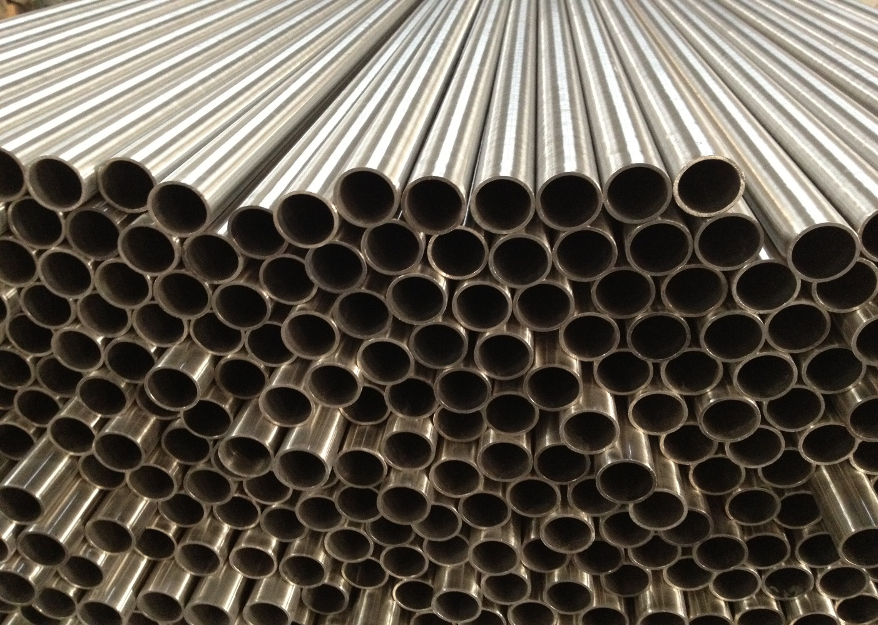
Titanium & Nickel & Zirconium

Slide 32
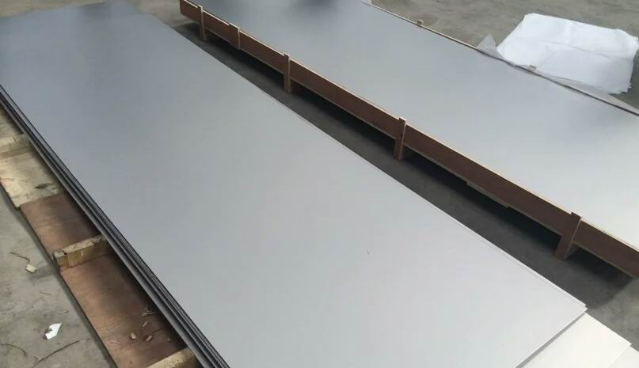
Titanium & Nickel & Zirconium

Slide 33
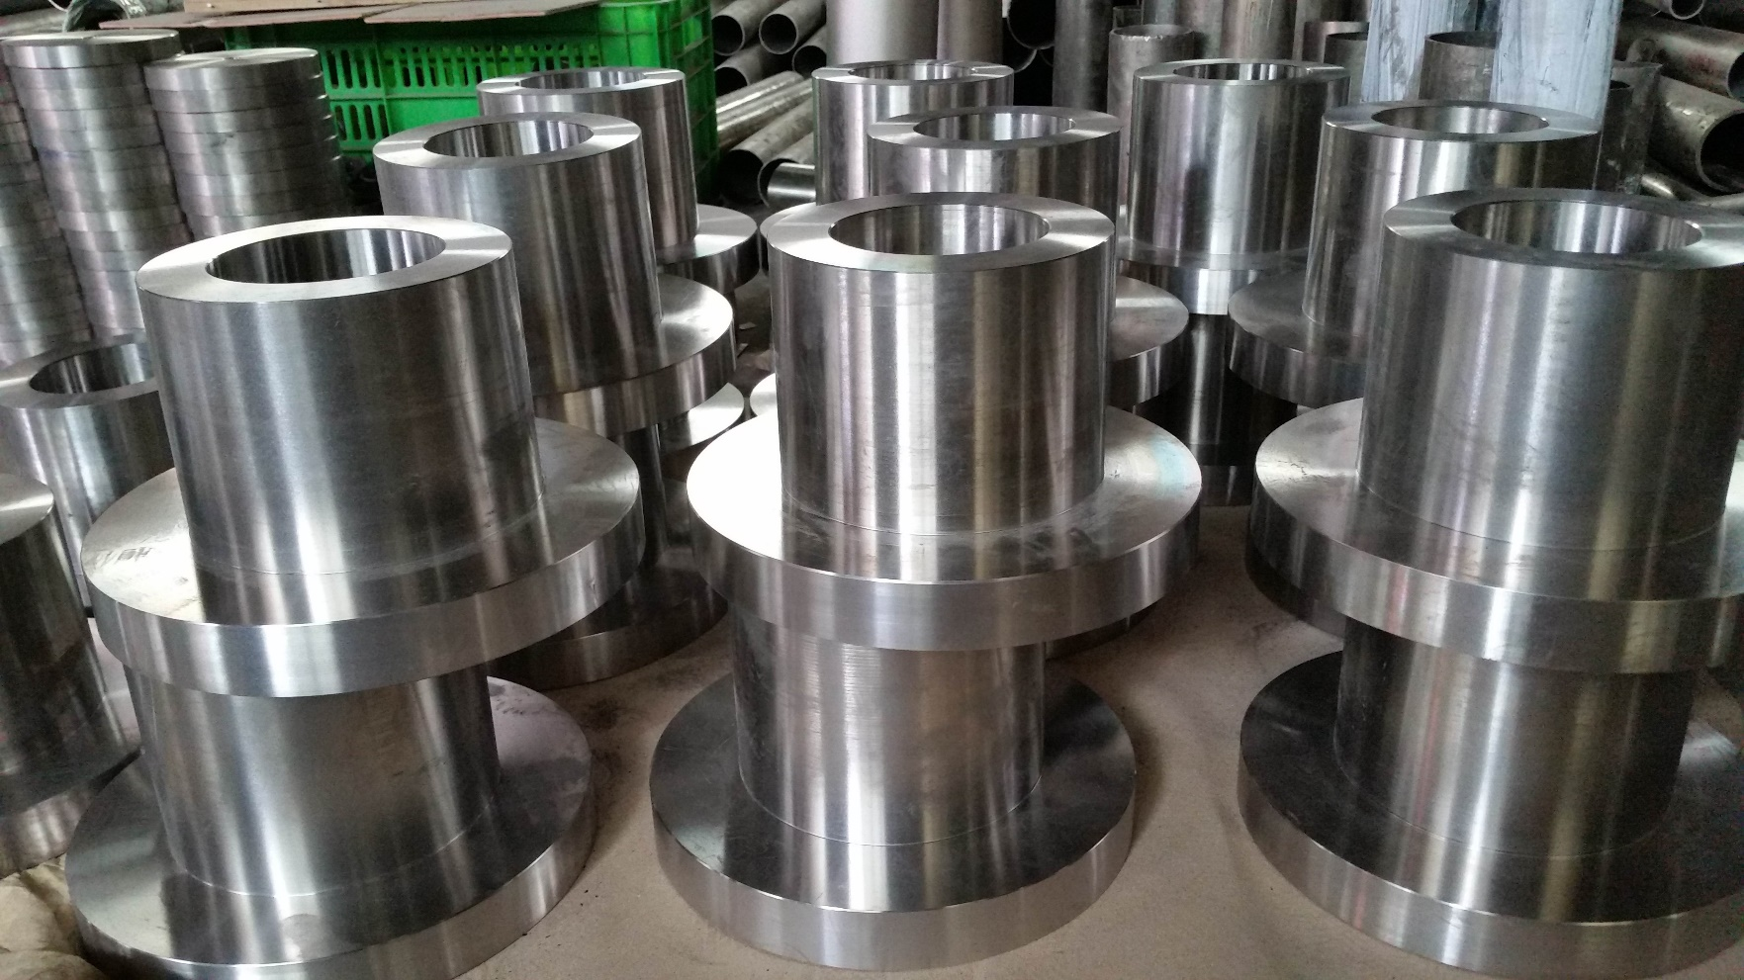
Titanium & Nickel & Zirconium

Slide 34
www.chinaporousfilters.com
Sintered Metal Porous Filters
Sintered Plastic Porous Filters
POROYAL
Medical & Lab Filters
Titanium & Nickel & Zirconium

Slide 35
03
Sintered Plastic Porous Filters
www.chinaporousfilters.com

Slide 36
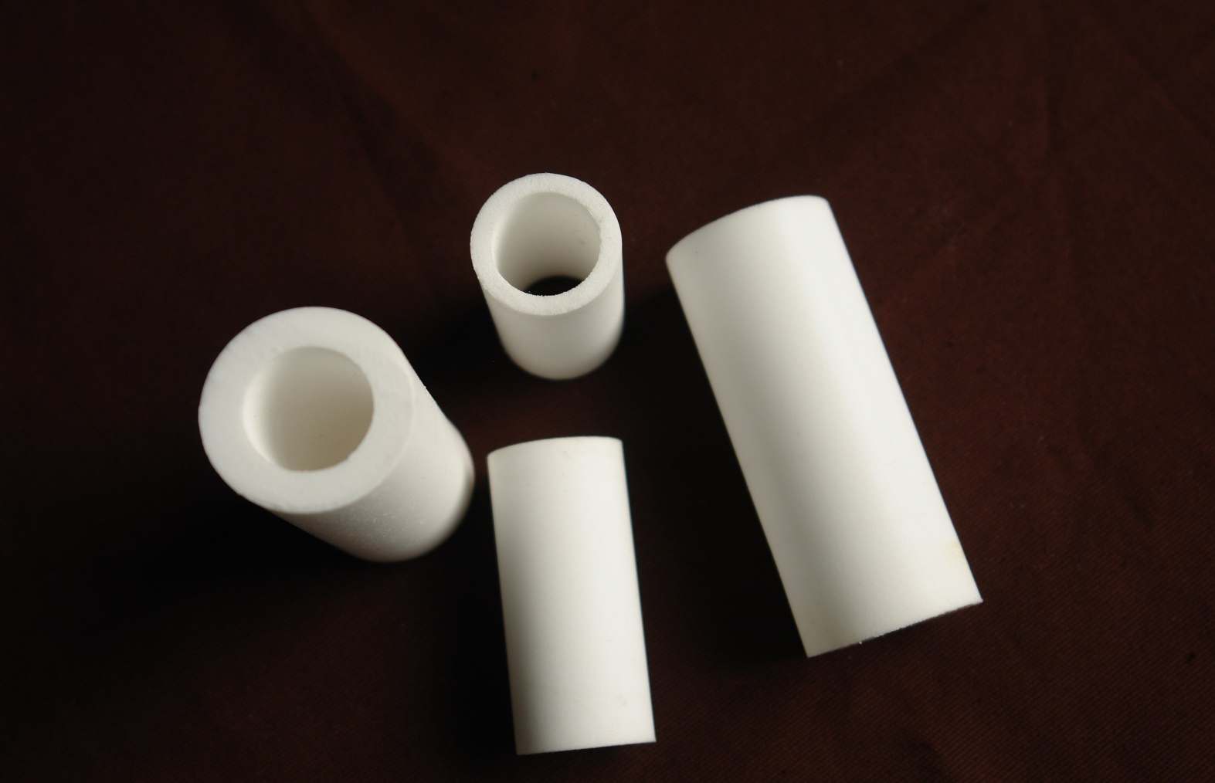
Sintered Plastic Porous Filters

Slide 37
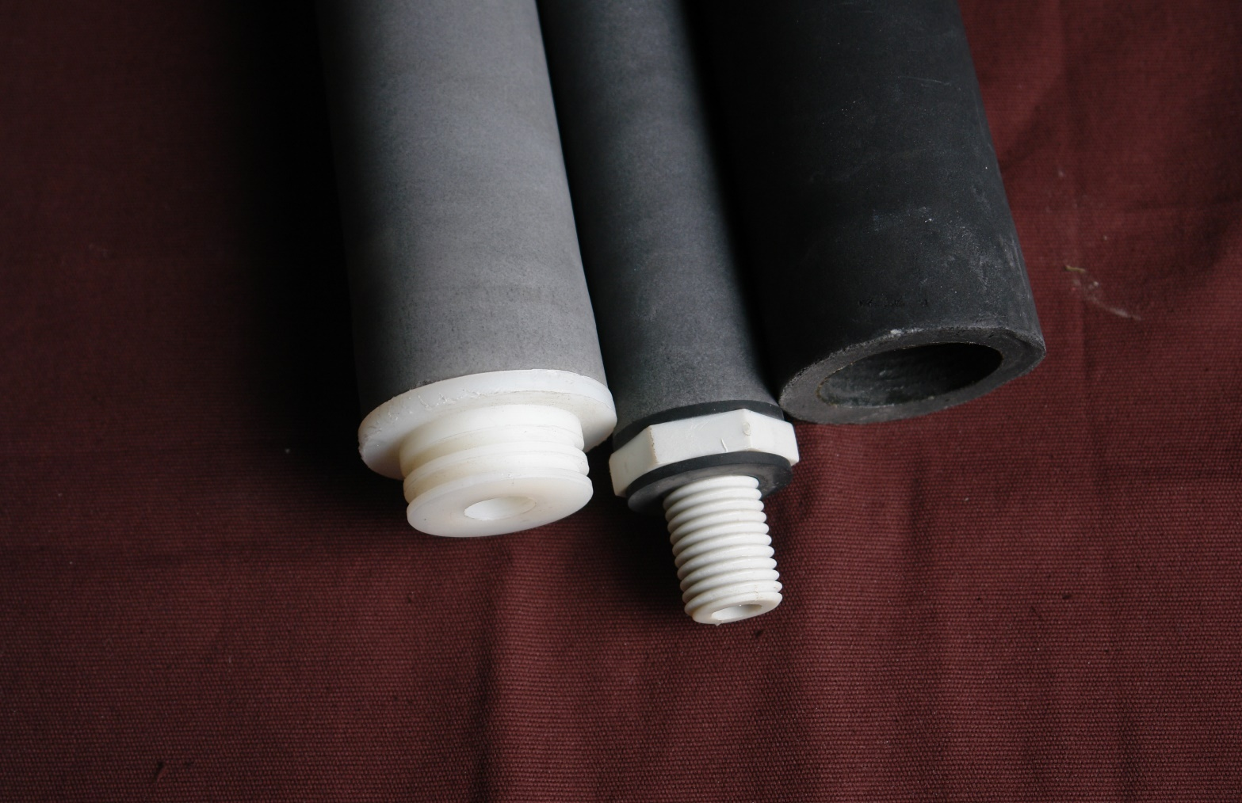
Sintered Plastic Porous Filters

Slide 38
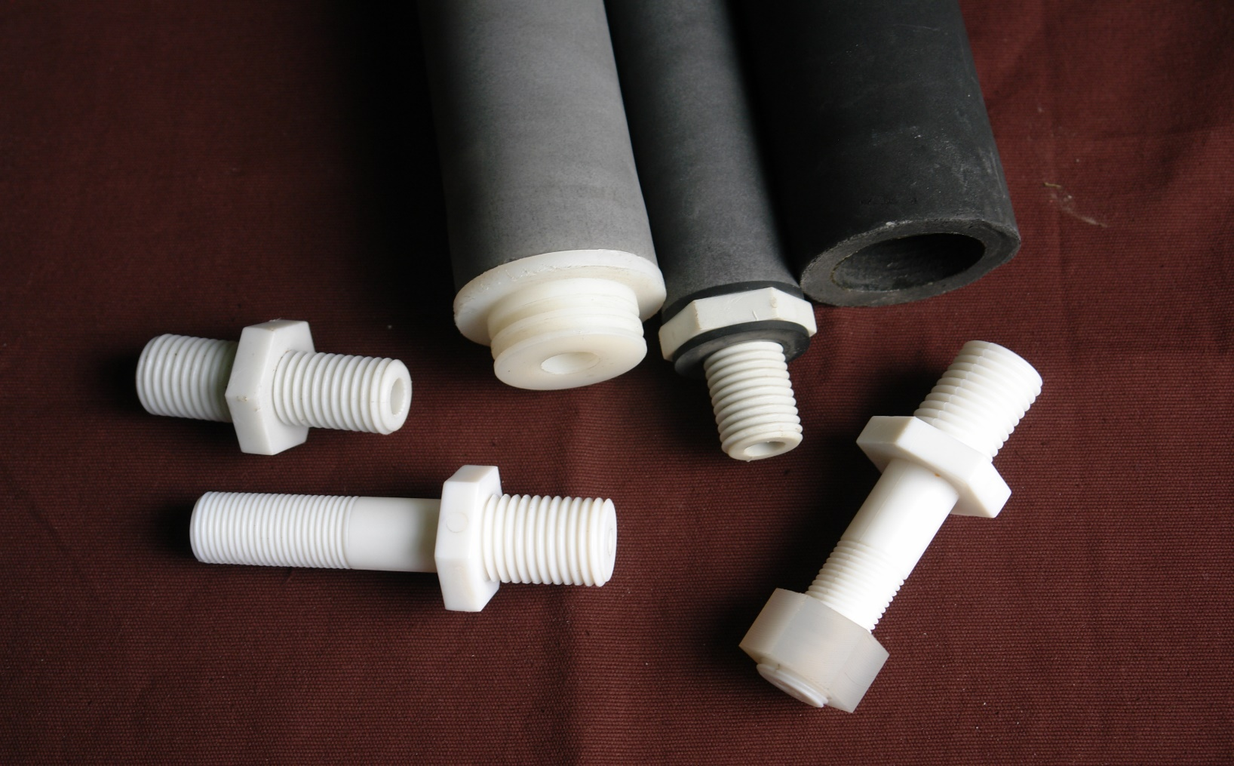
Sintered Plastic Porous Filters

Slide 39
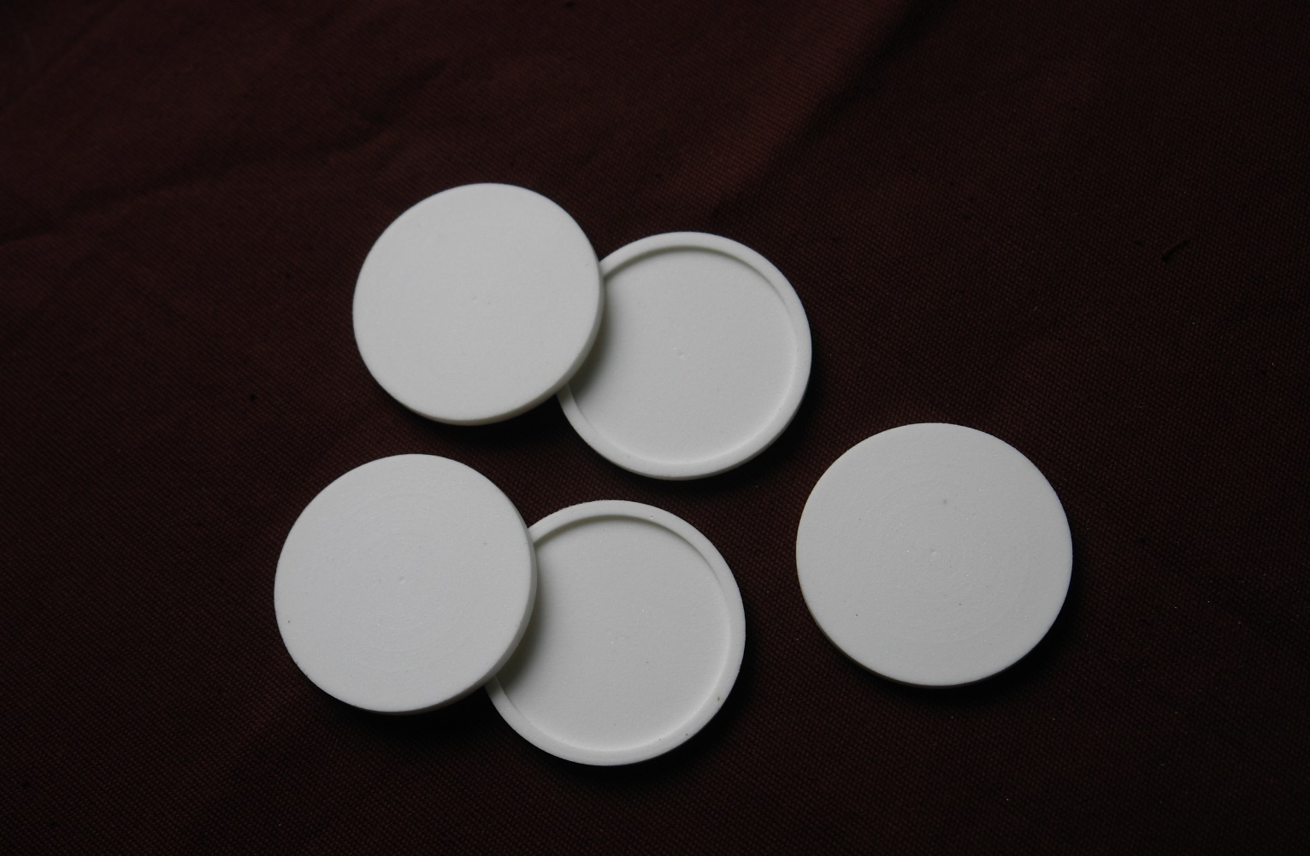
Sintered Plastic Porous Filters

Slide 40
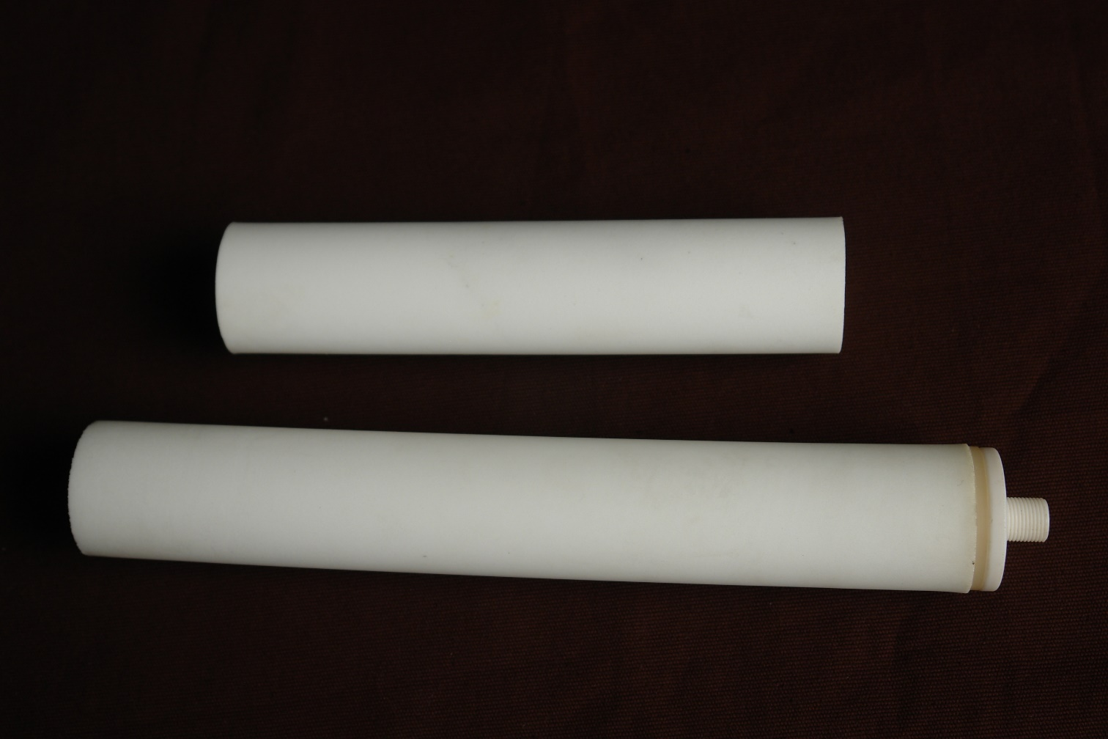
Sintered Plastic Porous Filters

Slide 41
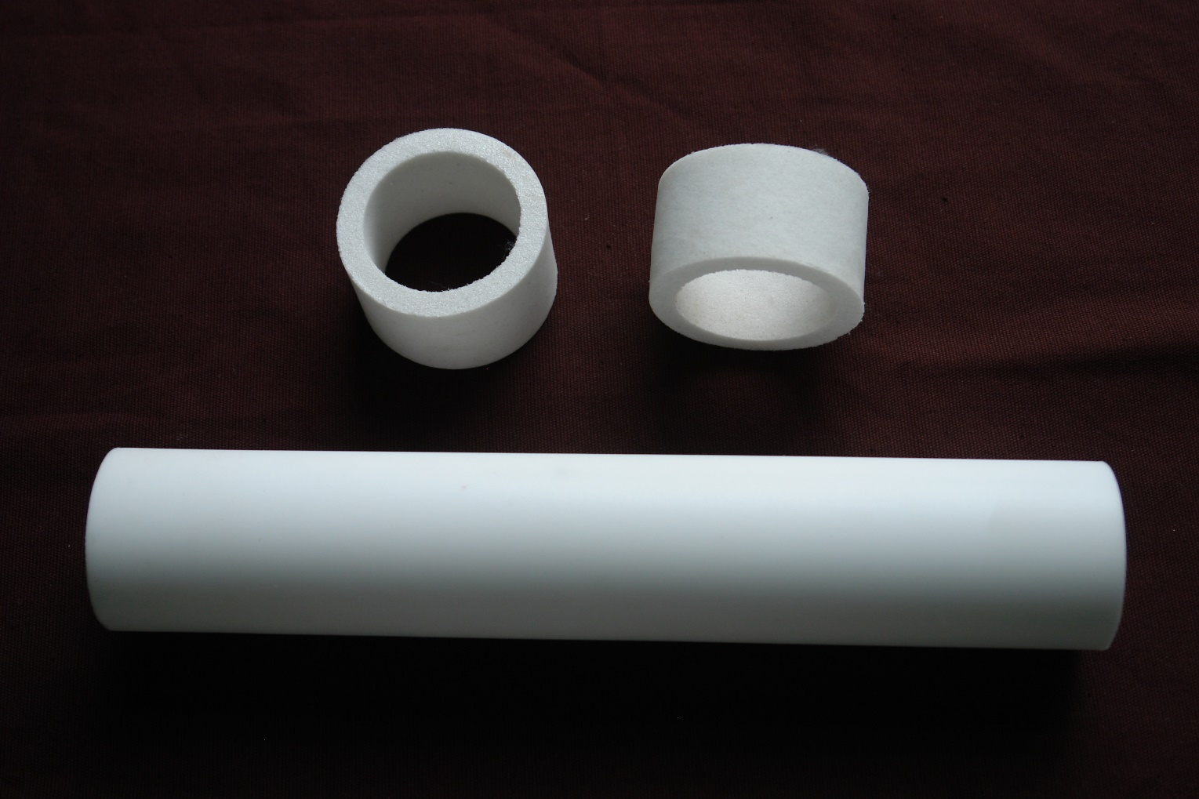
Sintered Plastic Porous Filters

Slide 42
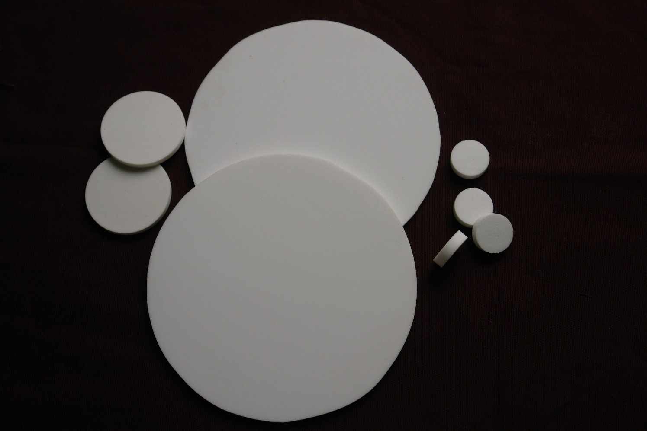
Sintered Plastic Porous Filters

Slide 43
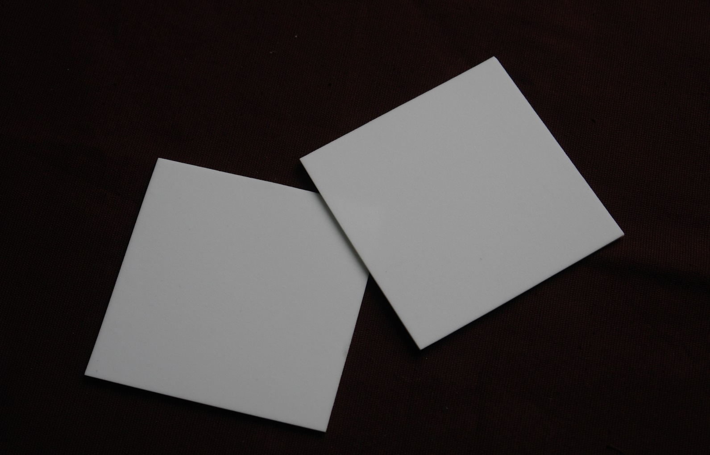
Sintered Plastic Porous Filters

Slide 44
www.chinaporousfilters.com
Sintered Metal Porous Filters
Sintered Plastic Porous Filters
POROYAL
Medical & Lab Filters
Titanium & Nickel & Zirconium

Slide 45
04
Medical & Lab Filters
www.chinaporousfilters.com

Slide 46
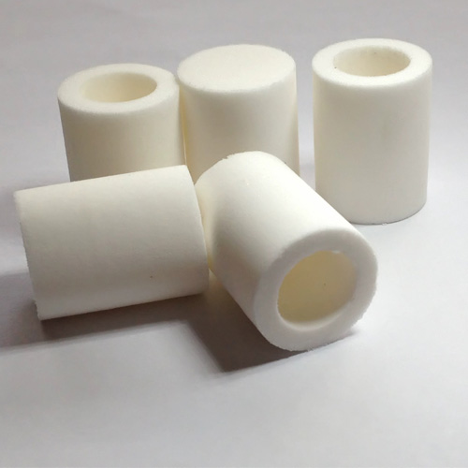
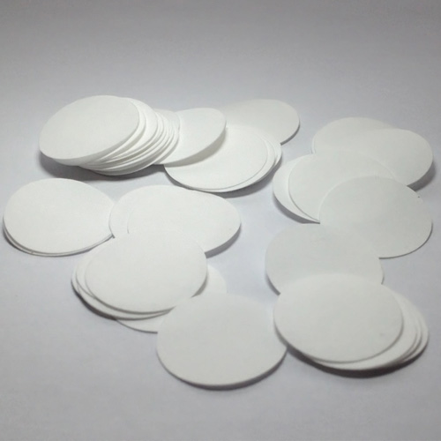
Medical & Lab Filters

Slide 47
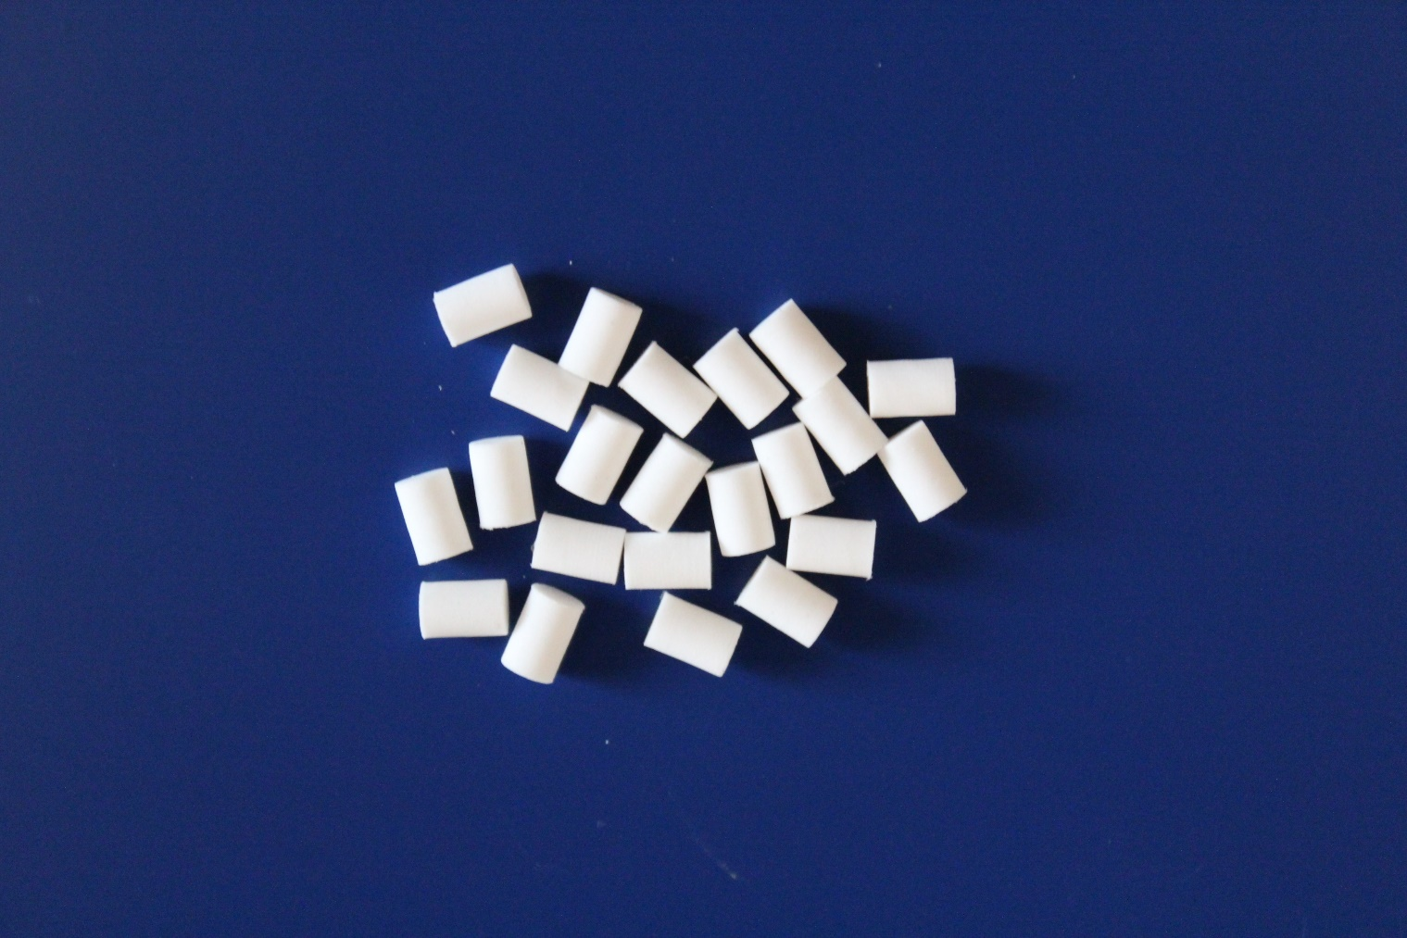
Medical & Lab Filters

Slide 48
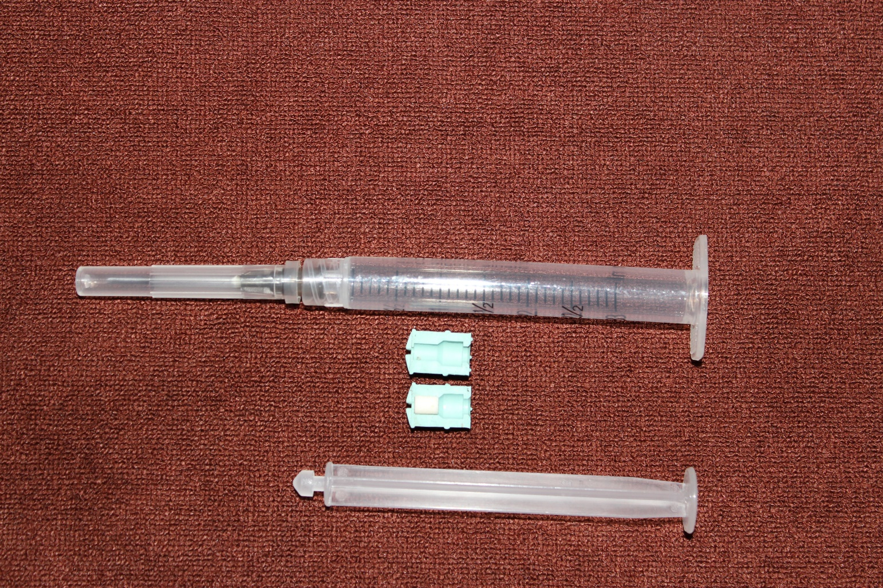
Medical & Lab Filters

Slide 49
Medical & Lab Filters

Slide 50
Medical & Lab Filters

Slide 51
Sintered Plastic Porous Filters

Slide 52
Medical & Lab Filters

Slide 53
Medical & Lab Filters

Slide 54
Medical & Lab Filters

Slide 55
Medical & Lab Filters

Slide 56
Medical & Lab Filters

Slide 57
www.chinaporousfilters.com
GERMANY
BRAZIL
INDIA
NETHERLANDS
USA
TURKEY
PORTUGAL
OMAN

Slide 58
www.chinaporousfilters.com
APPLICATIONS
◎ CATALYST RECOVERY
◎ FLUIDIZING-BED ELEMENTS
◎ ACTIVATED CARBON REMOVAL
◎ BLEACHING EARTH REMOVAL
◎ IMPURITIES REMOVAL
◎ AERATION

Slide 59
www.chinaporousfilters.com
APPLICATIONS
◎ PTA COLLECTION
◎ HIGH-TEMP. GAS FILTRATION
◎ POWDERS VACUUM FEEDING
◎ SENSOR PROTECTING
◎ PNEUMATIC SILENCER

Slide 60
www.chinaporousfilters.com
Sintered Metal Porous Filters
Sintered Plastic Porous Filters
POROYAL
Medical & Lab Filters
Titanium & Nickel & Zirconium

